Slide 1
Software Product, Process and Process Models

Slide 2
Software Product
Computer software is the product that software engineers design and build.
It encompasses:
Programs.
Documents in the form of hard and soft-copy.
Data that combine numbers and text, video, and audio information, images.

Slide 3
Overview
What? A software process – as a framework for the tasks that are required to build high-quality software.
Who? Managers, software engineers, and customers.
Why? Provides stability, control, and organization to an otherwise chaotic activity.
Steps? A handful of activities are common to all software processes, details vary.
Work product? Programs, documents, and data.

Slide 4
Characteristics of Software Process
Predictability of a process determines how accurately the outcome of follow- ing that process in a project can be predicted before the project is completed.
Support Testability and Maintainability in the life of software the maintenance costs generally exceed the development costs.
Support Change
Early Defect Removal
Process Improvement and Feedback

Slide 5
What is software engineering?
IEEE Definition :
(1) The application of systematic, disciplined, quantifiable approach to the development, operation, and maintenance of software; that is, the application of engineering to software.
(2) The study of approaches as in (1) above
Its a discipline that is concerned with all aspects of software production.
Software engineers should adopt
Systematic and organized approach to their work
Use appropriate tools and techniques depending on the problem to be solved
The development constraints and the resources available
Apply Engineering Concepts to developing Software
Challenge for Software Engineers is to produce high quality software with finite amount of resources & within a predicted schedule

Slide 6
Software process model
Process models prescribe a distinct set of activities, actions, tasks, milestones, and work products required to engineer high quality software.
To solve actual problems in an industry setting, a software engineer or a team of engineers must incorporate a development strategy that encompasses the process, methods, and tools layers and the generic phases.
This strategy is often referred to as a process model or a software engineering paradigm.
A process model for software engineering is chosen based on the nature of the project and application, the methods and tools to be used, and the controls and deliverables that are required.

Slide 7
Types of Process Model
Software development lifecycle model (Waterfall Model)
Prototyping model
V model
incremental Model
Iterative Model
Spiral Model
Agile Model

Slide 8
Problem Solving Loop
Status quo “represents the current state of affairs”.
Problem definition identifies the specific problem to be solved;
Technical development solves the problem through the application of some technology,
Solution integration delivers the results (e.g., documents, programs, data, new business function, new product) to those who requested the solution.

Slide 9
WaterFall Model
Also called the classic Software life cycle or Linear Sequential model,
Suggests a systematic, sequential approach to software development.
It has following Phases.
Software requirements analysis.
Design
Code Generation
Testing
Maintenence

Slide 10
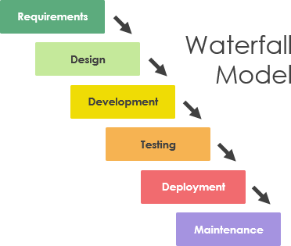
Analysis &
Design

Slide 11
System/information engineering and modelling
Work begins by establishing requirements for all system elements.
Leads to allocating subset of these requirements to software.
This system view is essential when software must interact with other elements such as hardware, people, and databases.

Slide 12
Software requirements analysis
Is intensified and focused specifically on software.
Analyst must understand
Information domain for the software,
Required function,
Behaviour
Performance
Interface.
Requirements for both the system and the software are documented and reviewed with the customer

Slide 13
Design
A multistep process that focuses on four distinct attributes of a program:
Data structure
Software architecture
Interface representations
Procedural (algorithmic) detail
Design process:
Translates requirements into software representation that can be assessed for quality before coding begins.
Is documented and becomes part of the software configuration.

Slide 14
Code generation / Development.
The design must be translated into a machine-readable form called code generation.
If design is performed in a detailed manner, code generation can be accomplished mechanistically.

Slide 15
Testing
Starts after code generation.
Focus on checking:
Logical internals of the software:
ensuring that all statements have been tested/
Functional externals
conducting tests to uncover errors and ensure that defined input will produce actual results that agree with required results.
In testing we perform both verification & validation.

Slide 16
Maintenance/ Support
Software will undergo change after it is delivered to the customer.
Change will occur because:
1. Errors have been encountered
2. Software must be adapted to accommodate:
a) changes in its external
b) customer needs for functional or performance enhancements.
Software support/maintenance reapplies each of the preceding phases to an existing program.

Slide 17
Advantages
This model is simple and easy to understand and use.
Easy to manage due to the rigidity of the model –
Phases are processed and completed one at a time.
Phases do not overlap.
Works well for smaller projects where requirements are very well understood.

Slide 18
Limitations:
1. Real projects rarely follow the sequential flow that the model proposes.
--Although the linear model can accommodate iteration, it does so indirectly.
--As a result, changes can cause confusion as the project team proceeds.
2. It is often difficult for the customer to state all requirements explicitly.
--The linear sequential model requires this and has difficulty accommodating the natural uncertainty that exists at the beginning of many projects.
3. The customer must have patience.
--A working version of the program(s) will not be available until late in the project time-span.
--A major blunder, if undetected until the working program is reviewed, can be disastrous.
4. Freezing the requirements usually requires choosing the hardware
5. It is a document-driven process that requires formal documents at the end of each phase.
Notes:
--A large project might take a few years to complete.
--If the hardware is selected early, then due to the speed at which hardware technology is changing, it is likely that the final software will use a hardware technology on the verge of becoming obsolete.
--This is clearly not desirable for such expensive software systems.
18

Slide 19
PROTOTYPING MODEL

Slide 20
THE PROTOTYPING MODEL
Need:
Customer defines a set of general objectives for software but is not able to identify detailed input, processing, or output requirements
The developer may be unsure of
Efficiency of an algorithm,
Adaptability of an operating system
Form that human/machine interaction should take.

Slide 21
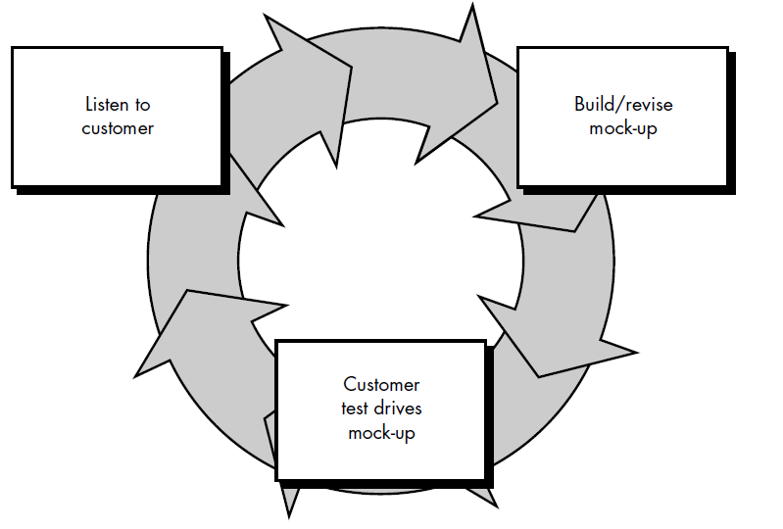

Slide 22
The Process:
Identify whatever requirements are known, and outline areas where further definition is mandatory.
A "quick design" occurs.
The quick design leads to the making of a prototype.
The prototype is evaluated by the customer/user and used to refine requirements for the software to be developed.
Iteration occurs as
Prototype is tuned to satisfy the needs of the customer,
Enables developer to better understand what needs to be done.
The prototype serves as a mechanism for identifying software requirement.
Notes:
The quick design focuses on a representation of those aspects of the software that will be visible to the customer/user (e.g., input approaches and output formats).
22

Slide 23
Often not used, as it is feared that development costs may become large.
However, in some situations, the cost of software development without prototyping may be more than with prototyping.
There are two major reasons for this:
First, the experience of developing the prototype might reduce the cost of the later phases when the actual software development is done.
Secondly, in many projects the requirements are constantly changing, particularly when development takes a long time.

Slide 24
Prototyping:
Suitable for projects where requirements are hard to determine
Confidence in the stated requirements is low.
Use of waterfall model in such projects leads to requirement changes and associated rework while the development is going on.
Requirements frozen after experience with the prototype are likely to be more stable.
Excellent technique for reducing some types of risks associated with a project.

Slide 25
Prototyping can be problematic
Following are reasons:
Software quality or long-term maintainability concerns
The developer often makes implementation compromises
Customer and developer must both agree that the prototype is built to serve as a mechanism for defining requirements.
Notes:
Following are reasons:
The customer sees what appears to be a working version of the software, unaware that in the rush to get it working no one has considered overall software quality or long-term maintainability.
The developer often makes implementation compromises in order to get a prototype working quickly. the developer may become familiar with these choices and forget all the reasons why they were inappropriate.
25

Slide 26
EVOLUTIONARY SOFTWARE PROCESS MODELS
Evolutionary models are iterative.
Enables development of increasingly more complete versions of the software.
Various models that come under this category:
The Incremental Model.
Spiral Model
WINWIN Spiral Model
The Concurrent Development Model

Slide 27
The Incremental Model
Combines elements of the linear sequential model (applied repetitively) with the iterative philosophy of prototyping.
Each linear sequence produces a deliverable “increment” of the software

Slide 28
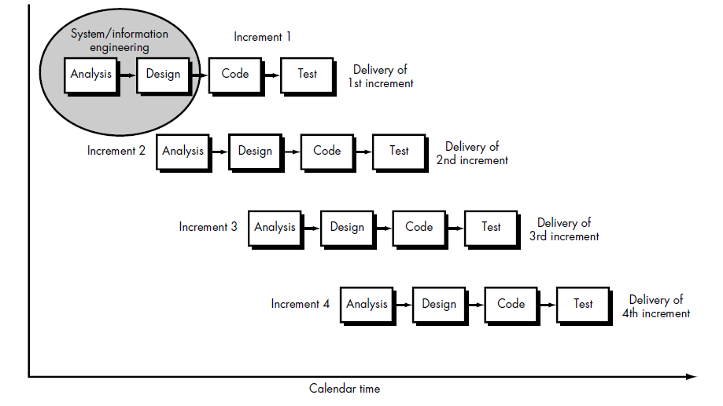

Slide 29
The Process
First increment is often a core product.
Basic requirements are addressed, but many supplementary features (some known, others unknown) remain undelivered.
The core product is used by the customer (or undergoes detailed review).
As a result of use and/or evaluation, a plan is developed for the next increment.
The plan addresses
the modification of the core product to better meet the needs of the customer.
delivery of additional features and functionality.
This process is repeated following the delivery of each increment, until the complete product is produced.
Focuses on the delivery of an operational product with each increment.

Slide 30
Difference between Prototype Model and Incremental Model
S.No | Prototype Model | Incremental Model
1. | Prototype model is a software development model where a prototype is built, tested and then refined as per customer needs. | Incremental Model is a software development model where the product is, analyzed, designed, implemented and tested incrementally until the product is finished.
2. | Phases- Requirement Analysis Quick Design Build Prototype User Evaluation Refining Prototype Implement and Maintain | Phases- Requirement Analysis Design and Development Testing Implementation

Slide 31
S.No | Prototype Model | Incremental Model
3. | It is suitable for high-risk projects. | Incremental model can’t handle large project.
4. | Cost of prototype model is Low. | Cost of incremental model is also Low.
5. | Flexibility to change in prototype model is Easy. | Flexibility to change in incremental model is Easy.
6. | It does not support automatic code generation. | It supports automatic code generation as results in minimal code writing.
7. | It does not give emphasis on risk analysis. | It give emphasis on risk analysis.
8. | In this user involvement is high. | In this user Involvement is only at the beginning.

Slide 32
 | Prototype Model | Incremental Model
Advantages- Active user involvement Errors get detected earlier User has better understanding of the developed system Easier modifications Quick user feedbacks leads to effective solutions | Advantages- Quick development of working software in software development life cycle Flexible Not expensive in case of changing scope and requirements Easy testing and debugging for a smaller iteration Customer is involved during each built Easy risk management

Slide 33
 | Prototype Model | Incremental Model
Disadvantages- Increased complexity because of a lot of user involvement Incomplete problem analysis | Disadvantages- Requirement of good planning and design Before dividing the system into smaller parts and built gradually, it must be completely and clearly defined.

Slide 34
V- Model
SDLC model where execution of processes happens in a sequential manner in V-shape.
Also known as Verification and Validation model.
Extension of the waterfall model
Association of a testing phase for each corresponding development stage.
Highly disciplined model and next phase starts only after completion of the previous phase.

Slide 35
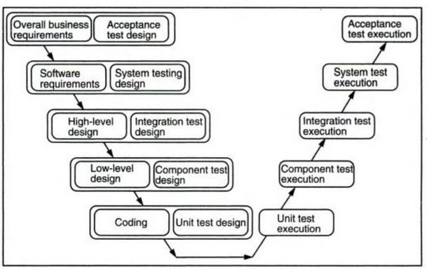
V-Model
Verification
Validation

Slide 36
Requirements like BRS and SRS begin the life cycle model
Before development starts, a system test plan is created.
Test plan focuses on meeting the functionality specified in the requirements gathering.
The high-level design (HLD) phase focuses on system architecture and design.
Provide overview of solution, platform, system, product and service/process.
Integration test plan is created to test the pieces of the software systems ability to work together.

Slide 37
Low-level design (LLD) The actual software components are designed.
Defines the actual logic for each and every component of the system.
Component tests are created.
Coding phase: All coding takes place here.
Output:
No. of program units,
Individual program units need to be tested independently before they are combined to form components.

Slide 38
Advantages of V-model:
Simple and easy to use.
Testing activities like planning, test designing happens well before coding, saving time
Higher chance of success over the waterfall model.
Proactive defect tracking – that is defects are found at early stage.
Avoids the downward flow of the defects.
Works well for small projects where requirements are easily understood.

Slide 39
Disadvantages of V-model:
1. Very rigid and least flexible.
2. No early prototypes of the software are produced.
3. If any changes happen in midway, then the test documents along with requirement documents has to be updated.

Slide 40
When to use the V-model:
For small to medium sized projects where requirements are clearly defined and fixed.
When ample technical resources are available with needed technical expertise.
High customer confidence is required.
For each type of test we move the design of tests along with the actual activities and retain the test execution after the product is built.

Slide 41
Questions
Is there ever a case when the generic phases of the software engineering process don't apply? If so, describe it.
Which of the software engineering paradigms presented here do you think would be most effective? Why?
Provide five examples of software development projects that would be amenable to prototyping. Name two or three applications that would be more difficult to prototype.
Propose a specific software project that would be amenable to the incremental model. Present a scenario for applying the model to the software.

